Slide 1
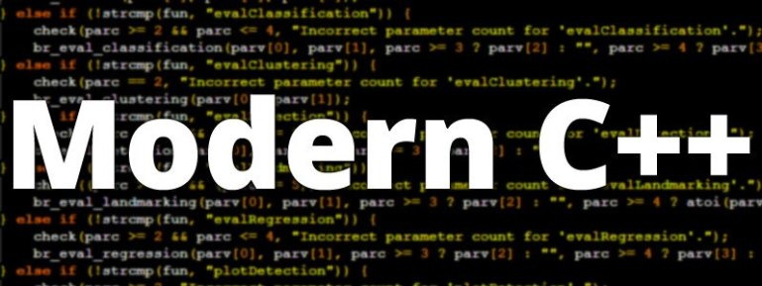
ADVAnce C++

Slide 2
MODERN C++
Introduction To std::array Class
std::array V/s C-style array
Declaring And Initializing
Member Functions

Slide 3
The std::array Class
The simplest standard container class is std::array which behaves just like a built-in ("C-style") array.
They are wrappers over C-style static arrays.
In order to use std::array class , we must include the header file <array>

Slide 4
std::array v/s C-Style array
The class std::array provides a rich set of functionality as compared to C-style arrays.
To understand the benefits of std::array class over C-style arrays , try answering the following questions:
Can you compare 2 C-style arrays using == operator ?
Does a C-style array knows its size ?
What happens when you pass a C-style array to a function ?
Can you swap 2 C-style arrays without writing your own logic ?
Can you sort a C-style array without writing your own logic ?
Can a C-style array prevent boundary overflow ?

Slide 5
std::array v/s C-Style array
The answers to all the questions in the previous slide are either No or unknown .
Now let us answer the same questions on std::array .
Can you compare 2 std::array using == operator ?
Yes , since == operator has been overloaded on std::array
Does a std::array knows its size ?
Yes , by calling its size() member function
What happens when you pass a std::array to a function ?
It’s passed as pass by value
Can you swap 2 std::array without writing your own logic ?
Yes , by calling the member function swap()
Can you sort an std::array without writing your own logic ?
Yes , by calling the function sort() of the header file <algorithm>
Can a std::array prevent boundary overflow?
Yes , it gives an exception called out_of_range

Slide 6
Declaring an std::array
In order to use std::array, we need to include a header file called <array> :
#include <array>
The declaration of std::array is as follows:
array<datatype,array_size> obj_name;
Example
array<int, 5> arr;
Here 'arr' is an object of the class std::array containing an array of type int and length 5.

Slide 7
Point to remember
Data type used while creating an std::array object an be any primitive or non primitive type
But size must ONLY BE an integer constant.

Slide 8
initializing an std::array
Like C-style arrays, we can initialize an std::array by simply assigning it values at the time of declaration.
Example:
array<int, 5> arr = {10, 20, 30, 40, 50};
//called initializer list
array<int, 5> arr {10, 20, 30, 40, 50};
// called as list initialization
array<int, 5> arr; arr= {10, 20, 30, 40, 50};

Slide 9
initializing an std::array
Like C-style arrays, we can initialize an std::array with lesser values but not with more number of values than size.
Example:
array<int, 5> arr= { 10, 20, 30, 40, 50 };
// okay
array<int, 5> arr= { 10, 20, 30 };
// okay, elements 3 and 4 are set to zero!
array<int, 5> arr= { 10, 20, 30, 40, 50,60 };
// not allowed, too many elements in initializer list!

Slide 10
Point to remember
Unlike C-style arrays, with std::array we can not omit the array length when providing an initializer:
Example
array<int, > arr { 10, 20,30,40,50 };
// illegal, array length must be provided
array<int> arr { 10, 20,30,40,50 };
// illegal, array length must be provided

Slide 11
Special case for c++ 17
However, since C++17, it is allowed to omit the type and size.
But there are 3 points to remember :
Both type and size have to be omitted together, but not one or the other
The array must be explicitly initialized.
Values must be of same type

Slide 12
Special case for c++ 17
Example:
array arr { 10,20,30,40,50};
// The type is deduced to std::array<int, 5>
array arr { 9.7, 7.31,3.4 };
// The type is deduced to std::array<double, 2>

Slide 13
Accessing individual value
We can access individual elements of a std::array in 2 ways:
Using [ ] operator
Using the member function at( )
Example:
array<int, 5> arr = { 10, 20, 30, 40, 50 };
cout << arr[2] << endl;
cout<<arr.at(2)<<endl;
Output:
30
30

Slide 14
An important point !
Question?
How [ ] and at( ) are different?
Answer
The method at( ) performs bound checking and will throw out_of_range exception if the index is beyond the length of the std::array while no such exception occurs in subscript operator

Slide 15
An important point !
Guess the output ?
array<int, 5> arr = { 10, 20, 30, 40, 50 };
cout << arr.at(6) << endl;
cout<<“Hello”;
Output:
out_of_range exception
The code is throwing exception since we are passing index 6 which out of the bounds. Also “Hello” will not be displayed

Slide 16
An important point !
Guess the output ?
array<int, 5> arr = { 10, 20, 30, 40, 50 };
cout << arr[6] << endl;
cout<<“Hello”;
Output:
0
Hello
This is garbage data and can be anything . The point to understand here is that no exception is occurring and “Hello” gets printed

Slide 17
array length
To get the length of the std::array , we can use either the size( ) or max_size( ) methods, which are members of the std::array class, and which return the number of elements in a std::array :
Example
array<int, 5> arr = { 10, 20, 30, 40, 50 };
cout << arr.size() << endl;
cout << arr.max_size() << endl;
Output:
5
5

Slide 18
An important point !
Question?
How size() and max_size( ) are different?
Answer
The difference is conceptual.
size() is the current number of elements in the container, and max_size() is the maximum elements the system allows for a container
Since the number of elements in std::array is constant, the current number of elements is exactly the same as the number of elements there can ever be.

Slide 19
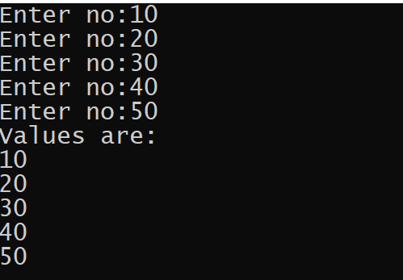
exercise
WAP to create an array of 5 integers .Now accept values from the user in it and display all the values

Slide 20
solution
#include <iostream>
#include <array>
using namespace std;
int main()
{
array <int,5>arr;
for(int i=0;i<arr.size();i++)
{
cout<<"Enter no:";
cin>>arr[i];
}
cout<<"Values are:"<<endl;
for(int i=0;i<arr.size();i++)
{
cout<<arr[i]<<endl;
}
return 0;
}

Slide 21
Passing array to function
Just like we can pass objects of our class as argument to functions , similarly we also can pass an std::array as argument
And as mentioned previously , it will be by default a pass by value

Slide 22
Example
#include <iostream>
#include <array>
using namespace std;
void printArray(array<int, 5> n)
{
cout << "length: " << n.size() << endl;
for (int j = 0; j < n.size(); j++ )
{
cout << "n[" << j << "] = " << n[j] << endl;
}
}
int main()
{
array<int, 5> n = {1,2,3,4,5};
printArray(n);
return 0;
}

Slide 23
Checking for empty Array
To check whether the std::array is empty or not we can use the method empty() which returns a Boolean value indicating whether the array is empty or not
Example:
array<int,0> first;
array<int,5> second;
cout << "first is empty ? " << first.empty()<<endl;
cout << "second is empty ?" << second.empty() ;
Output:
first is empty ? 1
second is empty ? 0

Slide 24
Getting first and last element
We can obtain the first and last element of an std::array object using its front() and back() methods respectively
Example:
array <int,5>arr={10,20,30,40,50};
cout<<"First element:"<<arr.front()<<endl;
cout<<"Last element:"<<arr.back();
Output:
First element: 10
Last element: 50

Slide 25
An important point
On an uninitialized std::array object front() and back() will return garbage value and on an empty std::array object they will generate unreported runtime error
Example:
array <int,5>arr;
cout<<"First element:"<<arr.front()<<endl;
cout<<"Last element:"<<arr.back();
Output:
First element: 8
Last element: 8

Slide 26
Filling the array
To fill the std::array object with same value in all the cells we can call its method fill()
Example:
array <int,5>arr={10,20,30,40,50};
arr.fill(15);
for(int i=0;i<arr.size();i++)
cout<<arr[i]<<endl;
Output:
15
15
15
15
15

Slide 27
Swapping array objects
We can swap the contents of two std::array objects by calling the swap() method.
This method exchanges the contents of the calling object with the contents of array object passed as argument.
Point to remember is that both the array objects must be of same type and size , otherwise syntax error will be generated

Slide 28
Swapping array objects
Example:
array <int,5>arr1={10,20,30,40,50};
array <int,5>arr2={5,7,9,11,13};
arr1.swap(arr2);
cout<<"First array:"<<endl;
for(int i=0;i<arr1.size();i++)
cout<<arr1[i]<<“ “;
cout<<endl<<"Secnd array:"<<endl;
for(int i=0;i<arr2.size();i++)
cout<<arr2[i]<<endl;
Output:
First array:
5 7 9 11 13
Secnd array:
10 20 30 40 50

